Slide 1
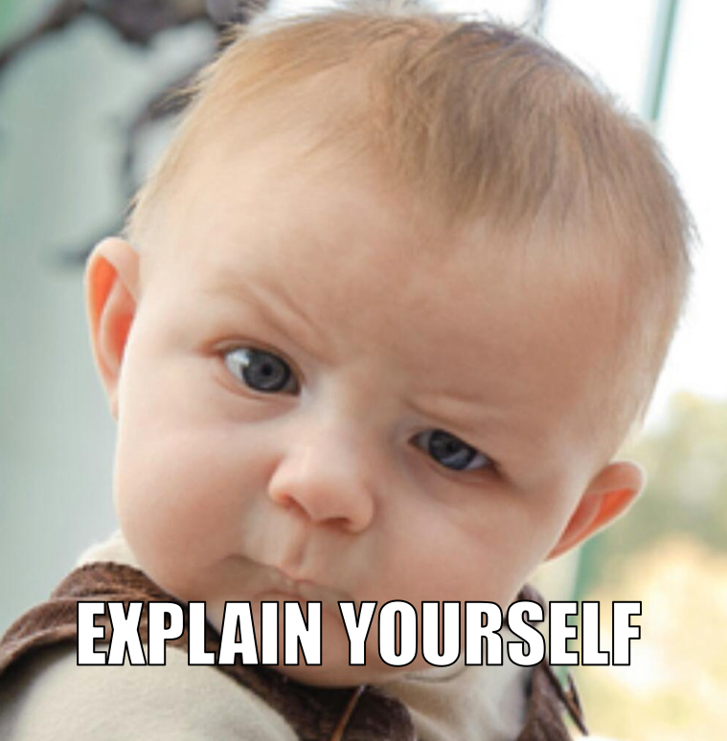
Babble Labble: Learning from Natural Language Explanations
Braden Hancock, Chris Ré, Percy Liang
DAWN Retreat Apr 2017

Slide 2
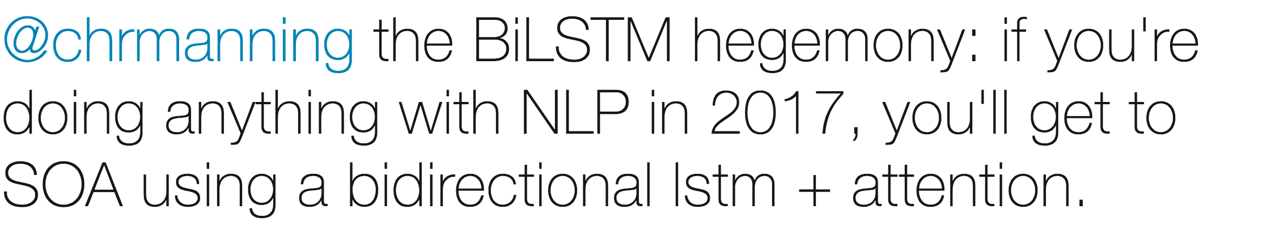

Slide 3
Labeled data
+
Deep Learning
=
State of the Art

Slide 4
(How can I get enough labels?)
“How can I get enough cookies?”

Slide 5
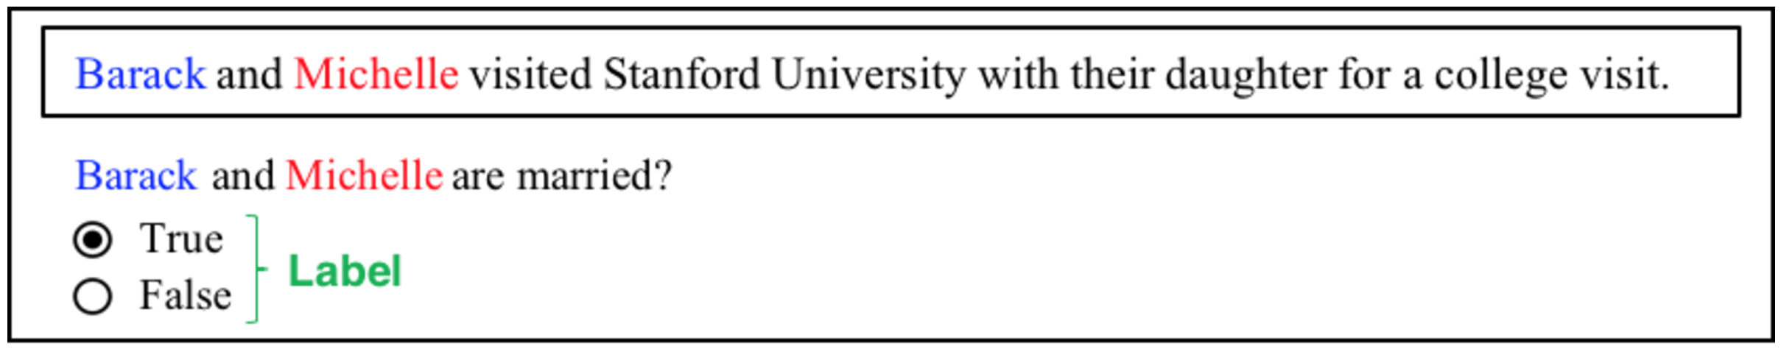
Option 1: With Labels (One by One)

Slide 6
Option 1: With Labels (One by One)

Slide 7
Option 1: With Labels (One by One)
Why?
Person1 is ‘Barack’
Person2 is ‘Michelle’
Visited is after Person2
Stanford University is in the sentence
‘and’ is between Person1 and Person2
Person1 is the first word in the sentence
‘and’ is the second word in the sentence
Person3 is the third word in the sentence
…
‘their daughter’ is after Person1 and Person2 in the sentence
…

Slide 8
“You’re getting warmer….”

Slide 9
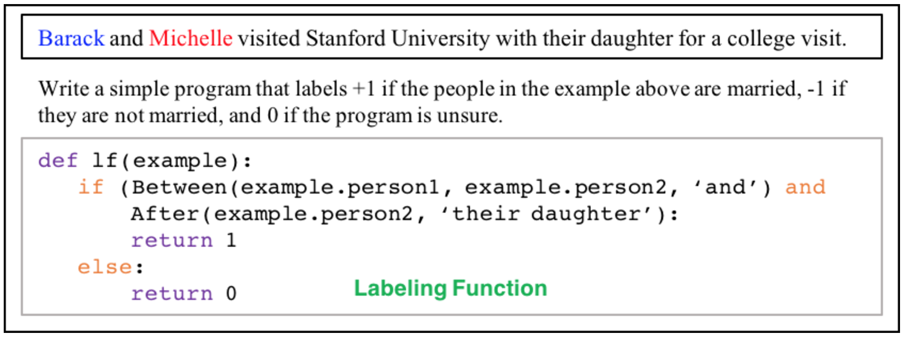
Option 2: With Labeling Functions (DP)

Slide 10
Option 2: With Labeling Functions (DP)
Pro:
Labeling scales (label 1000 examples at a time)
Con:
Not everyone can (or wants to) write programs!

Slide 11
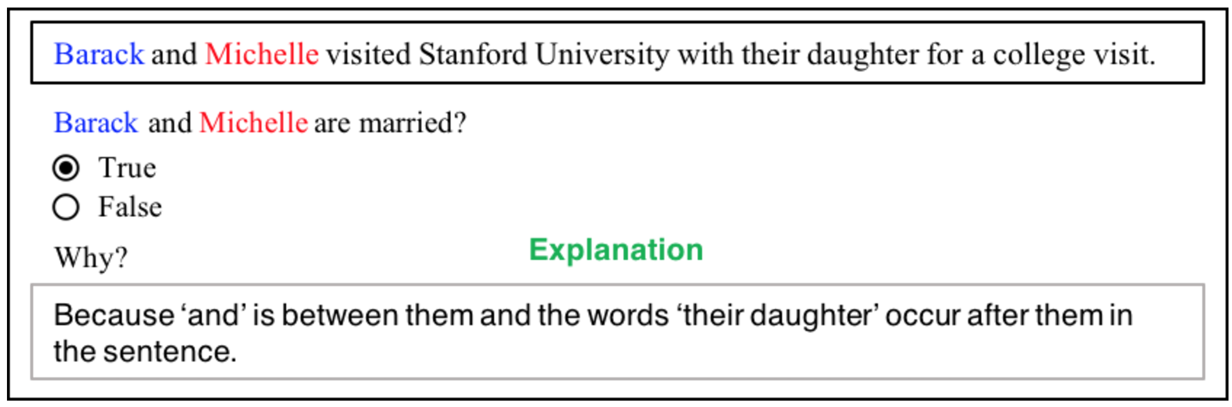
Option 3: With Explanations (Babble Labble)

Slide 12
Option 3: With Explanations (Babble Labble)
Pros:
Ease of use
Faster supervision
More sources of supervision
10x faster?
1000x more?
More people in the world can talk than can program
More written text in the world than programs

Slide 13
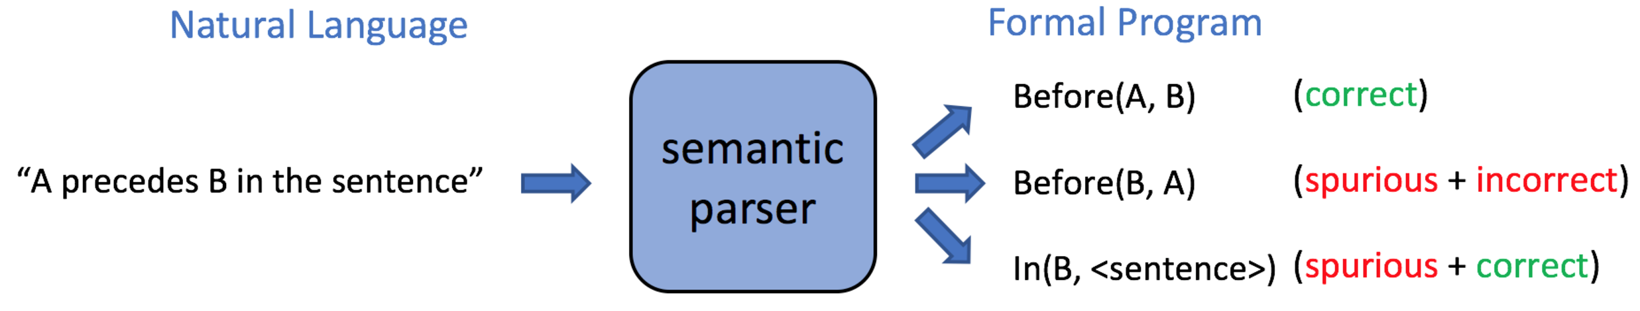
Semantic Parsing

Slide 14
Pipeline
Explanations
Labeling Functions
(not perfectly parsed)
def LF_1a(c)
return 1 if (
Explanation 1:
“True because the words ‘their daughter’ occur after them in the sentence”
After(c.Person1, ‘their daughter’) and
After(c.Person2, ‘their daughter’)
) else 0
def LF_1b(c)
return 1 if (
In(Sentence, ‘their daughter’)
) else 0
(possibly one-to-many)

Slide 15
Being “Accurate Enough”
Data Programming: Feed a larger set of “accurate enough” labels
to the discriminative model
Babble Labble: Feed a larger set of “accurate enough” LFs
to the generative model

Slide 16
Reason #1: Common Sense Filters
True
False
Abstain
Example contradiction
Uniform labels
Redundant signature
Input:
Contradiction:
( candidate, , LF )
LF (candidate) =
LF 1:
LF 1:
LF 2:

Slide 17

Reason #2: Model the mistakes
Model the LFs’ accuracies
Model the LFs’ dependencies
(Probably Wrong)
=
vs
=
Exp 1
Exp 2
Exp 3
Exp 4

Slide 18
Reason #3: Spurious LFs can be helpful!
Following the birth of their daughter, Beyoncé and Jay-Z took to Twitter to celebrate.
“‘their daughter’ precedes the people”
“they are preceded by ‘their daughter’”
“their daughter”

Slide 19
Experiment: Chemical-Disease Relations
True – “because ‘induced by’, ‘caused by’, or ‘due to’ is between the disease and the chemical”
False – “because a treatment word is between the chemical and the disease and the chemical is within 100 characters to the left of the disease”
False – “because the pair of canonical IDs of the chemical and the disease is in the therapeutic combinations dictionary”
contradiction
redundant
uniform
=
-
(
+
+
)
=
30 explanations
61 LFs
18 LFs
6 LFs
1 LF
36 LFs
Filters

Slide 20
Experiment: Chemical-Disease Relations
1000 gold labels
=
30 explanations
+ (examples for filtering)
*33x fewer labels

Slide 21
What Comes Next?
More domains, more tests, write it up for real

Slide 22
Feedback loop with semantic parser
Semantic Parser
Noisily
Labeled Data
Explanations
LFs

Slide 23
Learn from NL “In the Wild”: medical reports
DIAGNOSIS
Label
Explanation

Slide 24
Auto-Expansion of LFs
Original
Similarities
Expanded
Child
Son
Daughter
Baby
Kid
“True because the words ‘their daughter’ occur after them in the sentence”
Daughter ~
“True because the words ‘their [child, daughter, son, baby, kid]’ occur after them in the sentence”
“True because ‘wife’ is 3 words to the left of person 1”
2
3
4
“True because ‘wife’ is [2, 3, 4]’ words to the left of person 1”
3 ~

Slide 25
“Active Labeling”
The domain expert should only have to worry about the domain expertise.
Improving coverage
“Here are some candidates with no labels yet”
“Here are some candidates with many disagreements”
Improving explanations
“Here is an explanation with very low coverage”
“Here is an explanation with way too many LFs”

Slide 26
Let the cookies rain!

Slide 27
*Bonus: Utterly Ridiculous
Don’t semantic parse at all!
Count on the “needle in the haystack” in the high dimensional space
Explanation
Labeling Function
Label
“True because the words ‘their daughter’ occur after them in the sentence”
def LF_1a(c)
return 1 if (
LF_1a(candidate) = 1
After(c.Person1, ‘their daughter’) and
After(c.Person2, ‘their daughter’)
) else 0
Explanation
Embedding
Similarity Score
0.87
“True because the words ‘their daughter’ occur after them in the sentence”

